Slide 1
The Importance of Foreign Language
By: Lauren Falls

Slide 2
What are the benefits of learning a second language?

Slide 4
Economic Benefits

Slide 5
Here’s what teachers at MPHS had to say
Mrs. Davis
“It opens up all parts of your brain allowing you to be smarter in other areas, and you're more cultural aware.”
“There should be more foreign language requirements.”
Mrs. Ramereiz
“The biggest benefit of learning a language is that it allows you to communicate with other people.”
“In Europe being bilingual or multilingual is praised, as in some parts of America multilingualism is looked down upon. Younger children learn languages faster, and are more open to different cultures.”

Slide 6
The Current Standards
OR

Slide 7
Standards in France
Students are required to be proficient in two language in both general secondary school and technical secondary school.

Slide 8
Why is this a problem?

Slide 9
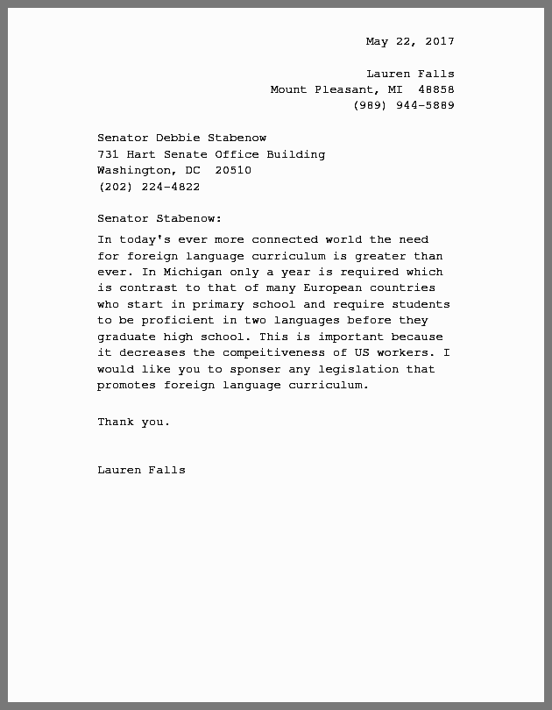
What can we do about it?
https://www.change.org/p/department-of-education-increase-the-amount-of-foreign-language-curriculum-in-the-united-states

Slide 10
Resources to help you learn
German
Duolingo
Dict.cc
Goethe Institute
FluentU German
Babbel.com
German is Easy
vocabulix.com
Youtube Channels
Easy German
Get Germanized
Deutsch Happen
Spanish
Duolingo
Dict.cc
FluentU Spanish
Babbel.com
Fluencia
Speakinglatino.com
vocabulix.com
Youtube Channels
Senor Jordan
Professor Jason
Easy Spanish
French
Duolingo
Dict.cc
FluentU
Bonjour de France
Babbel.com
Frenchassistant.com
conjugator.reverso.net/conjugation-french.html
Youtube Channels
Easy French
FrenchPod101
Learn French with Vincent

